Slide 1



Predictive Analysis of Traffic violations
Group 1

Slide 2

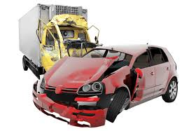

Introduction
Road accidents - big worldwide threat:
Up to 1.27 million deaths/year [2].
Up to 50 million injuries/year [2].
Over 2.5 millions/year involved in US [2].
Huge economic and social impact.
Data mining is arduous for traffic violations:
Huge data size and high dimensions [2-4].
Popularity of classification methods [3-5].
High dependence on collected data [3-5].
Testing multiple to choose the best [3-5].

Slide 3
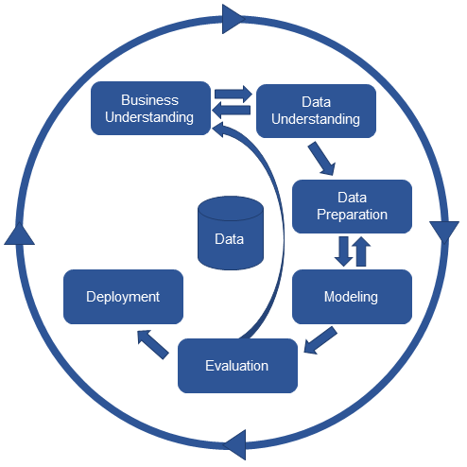
Flow of Project
Project followed CRISP-DM model and provided instructions
Selecting a dataset from any free source on web.
Study the variables in the selected dataset; draw preliminary conclusions; and develop at least three initial research questions/hypotheses.
Develop a Business Use Case.
Use the visualization (min of 5) to explore dataset; present research hypotheses, based on the visualizations.
Produce a dataset satisfying all of the criteria in part c.
Present 3 modeling techniques for hypotheses.
Develop models using 3 algorithm for each model.
Provide recommendations based on modeling results.

Slide 4

Dataset Chosen
Traffic Violations of MCP: records from 2012 to 2018
from https://catalog.data.gov/ (Jan 17, 2018)
Attributes:
Date of Stop
Time of Stop
Belts
Contribution Accident
Description
Phone Used
Fatal
Property damage
Violation Type
Hazmat
Notes:
Belts: If traffic violation involved a seat belt violation.
Personal Injury: If traffic violation involved Personal Injury.
Property Damage: If traffic violation involved Property Damage.
Fatal: If traffic violation involved a fatality.
HAZMAT: If the traffic violation involved hazardous materials.
Violation Type: Violation type. (Examples: Warning, Citation, SERO)
Geolocation: Geo-coded location information.

Slide 5

Data Preprocessing
Missing Data Handling
Two attributes i.e. “Agency” and “Accident” are removed from the dataset for being single-valued attributes with value 'No' for every one of the records.
Records with Null values are evacuated utilizing XL miners missing data treatment.
New Attributes
Three new binary-valued variables are presented to be specific, "Phone Usage", " Contributed to accident " and "Fatal" in light of the visualizations made for the dataset.
Outliers detection
Outliers are identified for the attribute "Year" and treated.
Filtering Datasets
For each search question separate datasets were created for modeling.
R programming language is utilized to accomplish balanced dataset with an equivalent weight of target variables.

Slide 6
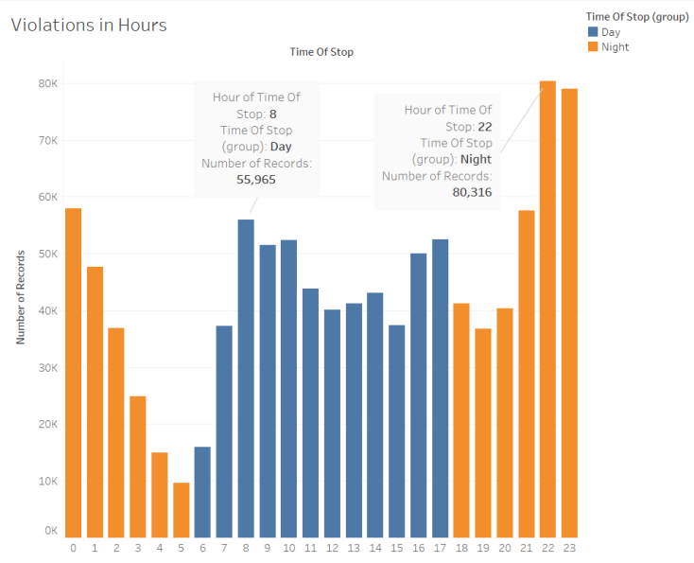
Visualizations - Violations based on hours

Slide 7
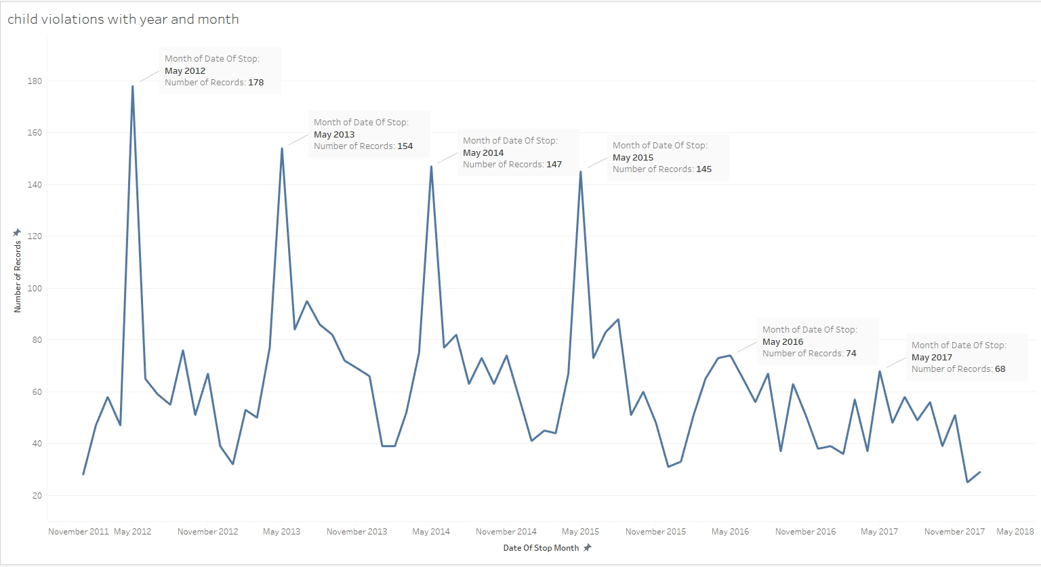
Visualizations - Child violations with year & month

Slide 8
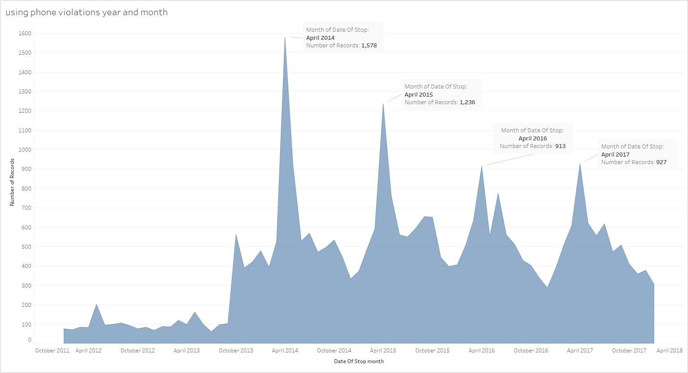
Visualizations - Phone violations with year & month

Slide 9
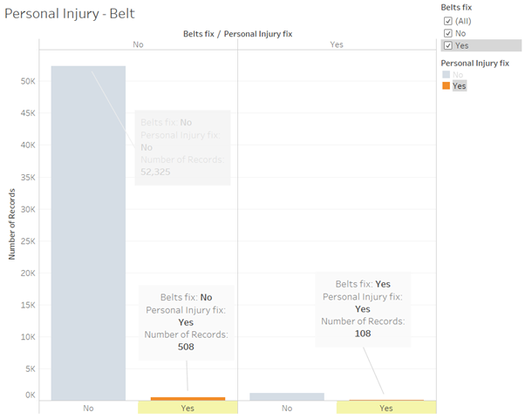
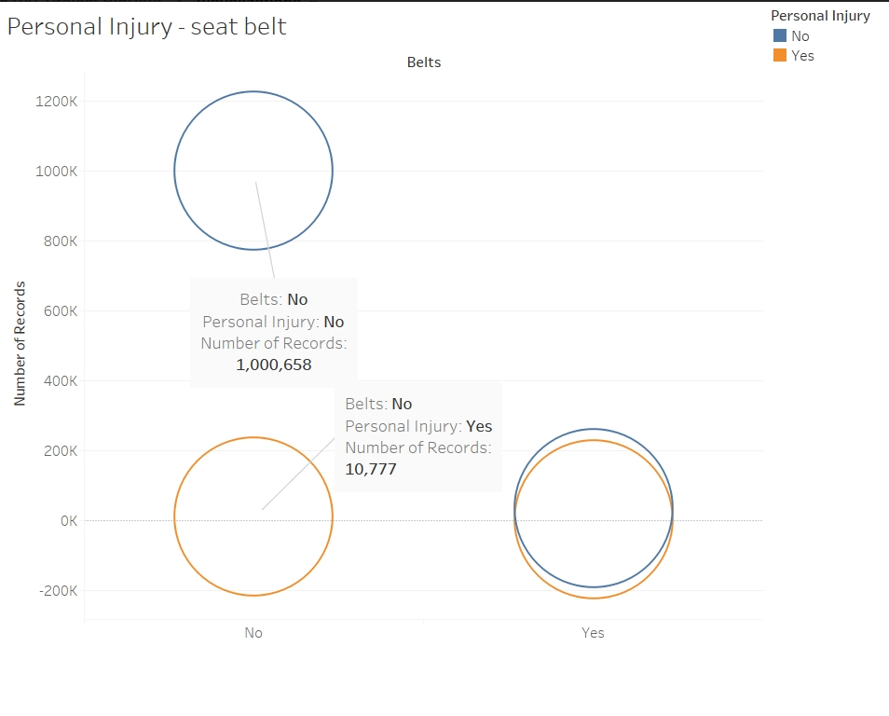
Visualizations - Violations with Personal injury & seat belt

Slide 10
Search Hypothesis
1
2
3
Whether a violation occurred contributed to an accident or not
Whether the violation that led to an accident was fatal or not
The geolocation, at which a violation is likely to occur based on several factors

Slide 11
Modeling
Model 2
Predictors:
Belt
HAZMAT
Alcohol
Phone Usage
Target variable:
Fatal
Model 3
Predictors:
Belt, Personal Injury
Property Damage
Alcohol
Violation Type
Target variable:
Cluster ID (geo-coordinates)
Model 1
Predictors:
Belt
Alcohol
Vehicle Type
Year
Phone Usage
Target variable:
Contributed to accident

Slide 12
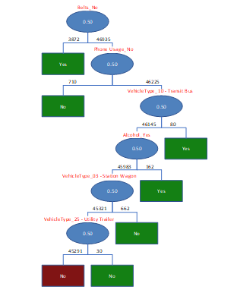
Model I: contrib. to accident
Belts
Algorithm | Single Tree | Random Trees | Naïve Bayes
Precision | 0.626 | 0.503 | 0.621
Sensitivity | 0.275 | 0.996 | 0.266
Specificity | 0.836 | 0.023 | 0.838
F1-Score | 0.383 | 0.669 | 0.373
Phone usage
Type: Bus
Alcohol
Best model: Random Trees due to highest sensitivity and F1-score
Belts and phone usage are the top predictors for contribution to accident

Slide 13
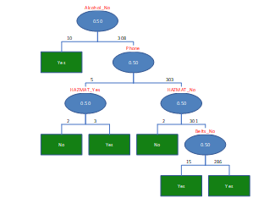
Model II: Fatality of accident
Algorithm | Single Tree | Random Trees | Naïve Bayes
Precision | 0.579 | 0.639 | 0.579
Sensitivity | 0.79 | 0.383 | 0.543
Specificity | 0.404 | 0.776 | 0.59
F1-Score | 0.668 | 0.478 | 0.561
Alcohol
Phone usage
HAZMAT
Best model: Single Tree due to highest sensitivity and F1-score
Alcohol and phone usage are the top predictors for fatal accidents

Slide 14
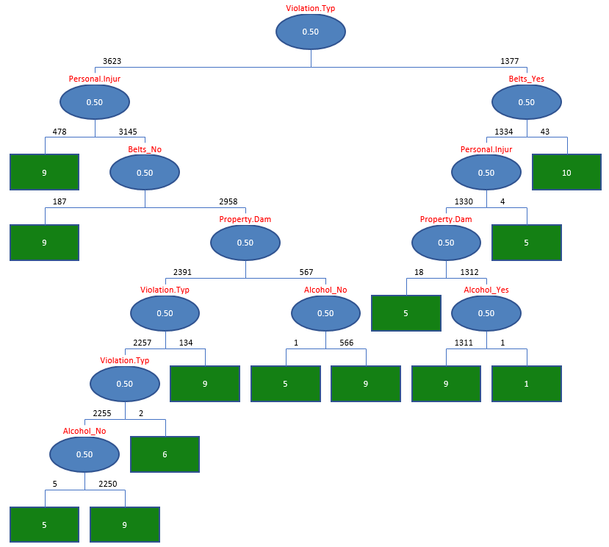
Model III: geolocation for “likely” violations
K-means clustering and Single Tree classification are best algorithms due to unbiased results
Cluster 5 has the highest number of alcohol violations and personal injuries
Cluster 9 has the highest number of belt violations

Slide 15

Recommendations
> Recommend MCP to increase their attention and increase enforcement of rules for belts and phone usage as the main reason for accident contribution
> Recommend MCP to pay an extra attention and take extra measures to drunk drivers and phone usage when driving
> Alert Maryland police about the major areas violations are likely to be caused:
>> high number of alcohol violations with personal injuries in cluster 5
>> multiple belt violations in cluster 9
> Perform similar recommendations to the insurance companies in the state of Maryland

Slide 16
Conclusion
5 visualizations have been produced and 3 research hypotheses developed;
Data preprocessed in several datasets;
3 modeling technique is performed for hypotheses;
Several classification, clustering and regression models have been considered for modeling: Single Tree, Random Trees, K-Means clustering, Multiple regression, etc.;
Random Trees and Single Tree are the best algorithms for models 1 and 2 due to an importance of high sensitivity and a high F1-score;
K-means clustering and Single Tree classification have been considered as the best algorithms for model 3 providing numbers of different types of violations along with the number of injuries for various clusters;
XLMiner, Tableau, and R are used for analysis.

Slide 17
References
Discovering Knowledge in Data: An Introduction to Data Mining, Daniel T. Larose and Chantal D. Larose, Wiley, 2nd edition: Wiley ISBN 978-0-470-90874-7
Abellan, J., Lopez, G., & De O~na, J. (2013). Analysis of traffic accident severity using Decision Rules via Decision Trees. Expert Systems with Applications, 40, 6047–6054.
Chang, L.-Y., & Chien, J.-T. (2015). Analysis of driver injury severity in truck-involved accidents using a non-parametric classification tree model. Safety Science, 51(1), 17–22.
Chen, W. H., & Jovanis, P. P. (2012). Method for identifying factors contributing to driver injury severity in traffic crashes. Transportation Research Record, 1717, 1–9.
Kashani, A. T., Rabieyan, R., & Besharati, M. M. (2014). A data mining approach to investigate the factors influencing the crash severity of motorcycle pillion passengers. Journal of Safety Research, 51, 93–98.
Kwon, O. H., Rhee, W., & Yoon, Y. (2015). Application of classification algorithms for analysis of road safety risk factor dependencies. Accident Analysis and Prevention, 75, 1–15.
Xie, Y., Zhang, Y., & Liang, F. (2009). Crash injury severity analysis using Bayesian ordered probit models. Journal of Transportation Engineering ASCE, 135(1), 18–25.
Mujalli, M. O., & de O~na, J. (2011). A method for simplifying the analysis of traffic accidents injury severity on two-lane highways using Bayesian networks. Journal of Safety Research, 42, 317–326.
De O~na, J., Lopez, G., & Abellan, J. (2013). Extracting decision rules from police accident reports through decision trees. Accident Analysis & Prevention, 50, 1151–1160.

Slide 18
QUESTIONS ?

